Slide 1

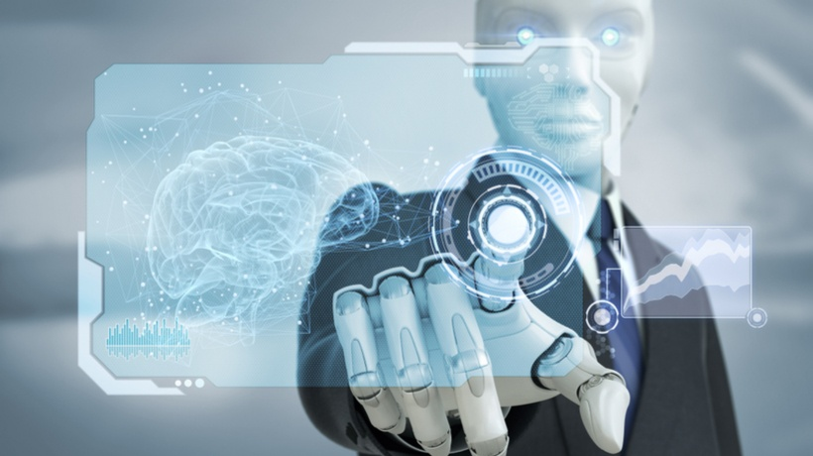
K.K.Wagh Education Society’s
K.K.Wagh Polytechnic,Nashik
Department of Information Technology
TOPIC: AI Based Personal Assistant
Team Members :
Khushal Nikam
Prathmesh Sanap
Tushar Padaya
Yash Raut
Project Guide: S.S.Dhoot

Slide 2

AGENDA
Introduction
Literature survey
Project requirement analysis
Design concept
Block diagram
Working system
References and Biography
Conclusion

Slide 3

INTRODUCTION
In response to modern technology challenges, we're developing an AI-based Personal Assistant.
We aim to meet the demand for multilingual digital assistants that enhance user productivity.
Our research targets inclusivity, making technology accessible to non-English speakers like Hindi users.
We focus on creating an AI Personal Assistant with multilingual and advanced problem-solving capabilities.
Our goal is to contribute to AI understanding and improve technology accessibility worldwide.
This research is vital for the scientific community and technology stakeholders shaping the digital future for all users.

Slide 4


Literature Survey
The literature survey for problem identification and specification in the development of an AI-based Personal Assistant highlights three key research papers.
The first paper, "IntelliAssistant," explores the significance of AI chatbots in business, customer service, and entertainment, emphasizing their ability to save time and increase customer satisfaction. It introduces a novel chatbot that learns from previously unanswerable questions, expanding its dataset through machine learning and artificial intelligence.
The second paper, "AI-Based Virtual Assistant Using Python," discusses intelligent virtual assistants and their capabilities, including understanding spoken language and performing various tasks. It emphasizes the application of artificial intelligence in creating virtual personal assistants.
The third paper, "Research Paper on Desktop Voice Assistant," focuses on creating a personal virtual assistant for Windows using Python, which recognizes user voice and processes commands.

Slide 5
Project Requirement Analysis
Functional Requirements
Voice Command Recognition
Information Retrieval
The system accurately recognizes and processes voice commands in multiple languages.
The AI Assistant efficiently retrieves information from various sources to answer user queries.
Math Problem Solving
Code Generation
The system solves a wide range of mathematical problems and equations accurately.
The AI Assistant generates code snippets in various programming languages based on user specifications.
Multilingual Support
Proactive Communication
The system supports interactions in multiple languages and understands different dialects.
The AI Assistant proactively provides information and assistance, reducing reliance on notifications.

Slide 6

Feasibilities of Project
1
Technical Feasibility
The project is technically feasible due to the availability of established technologies and development tools for voice recognition, NLP, and machine learning.
2
Economic Feasibility
Economic feasibility depends on a cost-benefit analysis to determine whether the project's benefits outweigh its development and maintenance costs.
3
Operational Feasibility
Operational feasibility focuses on whether the project can be implemented within the existing organizational framework and whether the necessary resources and expertise are available.

Slide 7

Design concept
The project features an AI-Based Personal Assistant, designed for voice and text interactions, catering to users' needs.
The assistant's primary functions include handling queries, retrieving information, offering solutions, and initiating proactive communication.
It targets a diverse user base, including students and professionals, and supports multiple languages, such as Hindi and English.
The system integrates with third-party services and data sources, like web search engines and APIs, to enhance its knowledge and provide comprehensive responses.
Accessible through various devices and platforms, it ensures a flexible user experience, connecting users with external resources for a seamless, efficient, and user-centric interaction.

Slide 8

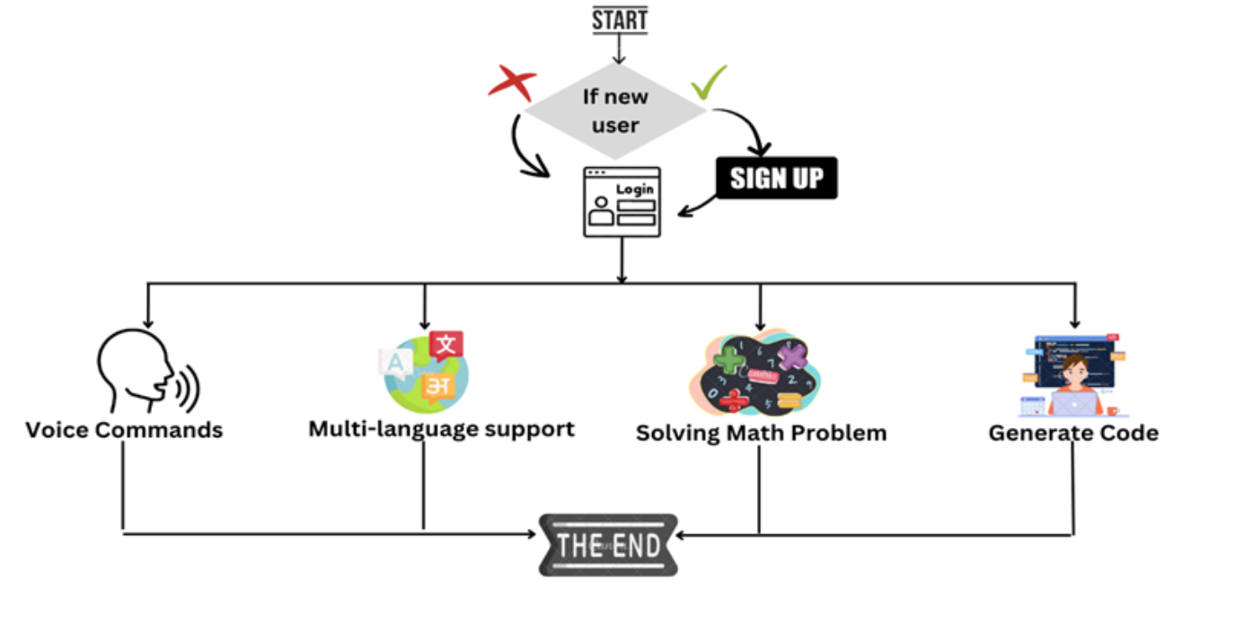
BLOCK DIAGRAM

Slide 9

WORKING SYSTEM
User Registration: Users can directly use this Assistant through browser. They register by providing their email or creating new Account.
User Interaction: Users interact with the AI Personal Assistant through a user interface that includes voice input and display output components.
Voice Input Processing: Voice commands provided by the user are initially processed through a speech recognition module, are further interpreted and translated into actionable tasks for the AI assistant.
Natural Language Processing (NLP): The system employs deep learning models like RNNs and CNNs to comprehend the user's intent and context, allowing for accurate interpretation of voice commands.
Problem-Solving & Code Generation: Mathematical problem-solving and code generation are key functionalities of the assistant. It uses symbolic mathematics libraries and problem-solving heuristics to address mathematical queries. Code generation is performed through machine learning algorithms.
Proactive Communication: Proactive communication is managed in this block, where the assistant can automatically speak when required instead of relying on notifications. Text-to-speech (TTS) synthesis is used to generate vocal responses.
g...

Slide 10
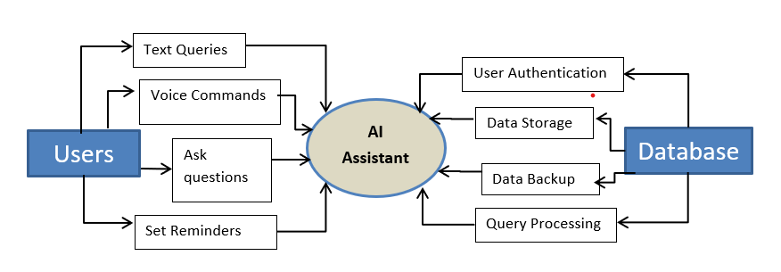
DFD Level - 0

Slide 11
References
V. Sharma, M. Goyal, and D. Malik, “An intelligent behavior shown by chatbot system,” International Journal of New Technology and Research, vol. 3, no. 4, 2017: 03
2. Vishal Kumar Dhanraj, Lokesh kriplani, Semal Mahajan, ”Research Paper on Desktop Voice Assistant” International Journal of Research in Engineering and Science, Volume 10 Issue 2, February 2022: 04
3. Patil Kavita Manojkumar, Aditi Patil, Sakshi Shinde, Shaktiprasad Patra, Saloni Patil, “AI-Based Virtual Assistant Using Python: A Systematic Review” , 12 March 2023: 05
Biography
https://ieeexplore.ieee.org/search/searchresult.jsp?newsearch=true&queryText=artificial%20intelligence
https://www.researchgate.net/publication/351456234_IntelliAssistant__AI_based_Personal_Assistant
https://www.scirp.org/journal/paperinformation.aspx?paperid=111666
https://www.ijraset.com/research-paper/ai-based-virtual-assistant-using-python-a-systematic-review

Slide 12
Conclusion
The development of the AI-based Personal Assistant represents a significant advancement in the realm of digital assistance and human-computer interaction. This project's main finding underscores the importance of a versatile, multilingual, and voice-driven AI assistant capable of efficient math problem-solving and code generation. Such an AI personal assistant not only simplifies daily tasks but also enhances accessibility, productivity, and user satisfaction. For future studies, it is recommended to further investigate the project's performance in real-world scenarios across a broader user base. This includes assessing its effectiveness in specialized domains and exploring additional features to enhance user experience and utility. Additionally, ongoing research into ethical considerations and user privacy in AI personal assistant technology is imperative to ensure responsible and secure usage.

Slide 13


